Slide 1
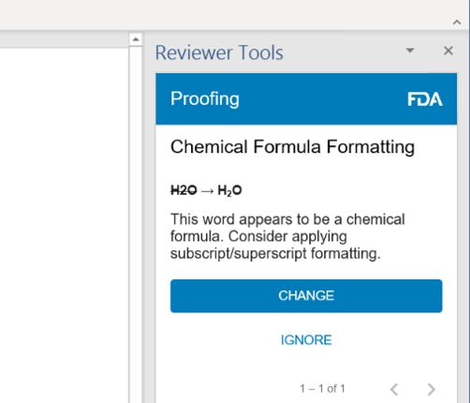
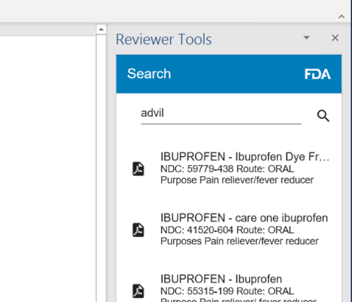
Introducing custom Microsoft Word add-ins can address traditional word processing shortcomings at the FDA.
Proof.
Search.
Collaborate.
Make chemistry formatting corrections before submitting documents
Search for FDA labels while editing documents
Synchronize content and formatting changes between platforms.
Bidwell et al., Session 2, AMIA 2020 Clinical Informatics Conference
FDA, Center for Drug Evaluation and Research (CDER), Office of Translational Sciences (OTS)
https://reviewer-tools.com

